Slide 1

Phishing Awareness Training: Spot, Stop, and Secure
Protect Yourself and Our Organization from Cyber Threats
According to the FBI, phishing is the #1 cybercrime, costing businesses billions annually.
Goal: Equip you with the knowledge to identify and avoid phishing attacks.

Slide 2
What is Phishing?
Definition: A type of cyberattack that uses deceptive emails, websites, or messages to steal sensitive information.
Examples of Information Targeted: usernames, passwords, credit card details, personal information

Slide 3
Types of Phishing Attacks
1
Email Phishing: The most common type, using deceptive emails.
2
Spear Phishing: Targeted attacks on specific individuals or groups. 91% of cyberattacks begin with a spear phishing email (Source: SANS Institute).
3
Whaling: Targeting high-profile individuals (CEOs, CFOs)
4
Smishing: Phishing via SMS text messages (10x higher engagement rate than email).
5
Vishing: Phishing via phone calls.

Slide 4
Recognizing Phishing Emails: Red Flags
Suspicious Sender Address: Look for misspellings or unusual domains. Example: "amaz0n.com" instead of "amazon.com".
Generic Greetings: "Dear Customer" instead of your name. Personalized emails are 6x more effective (Source: Experian).
Sense of Urgency: Demands immediate action or threatens consequences.
Poor Grammar and Spelling: A hallmark of many phishing attempts.
Suspicious Links: Hover over links to check the destination URL before clicking.
Requests for Personal Information: Legitimate organizations rarely ask for sensitive details via email.

Slide 5
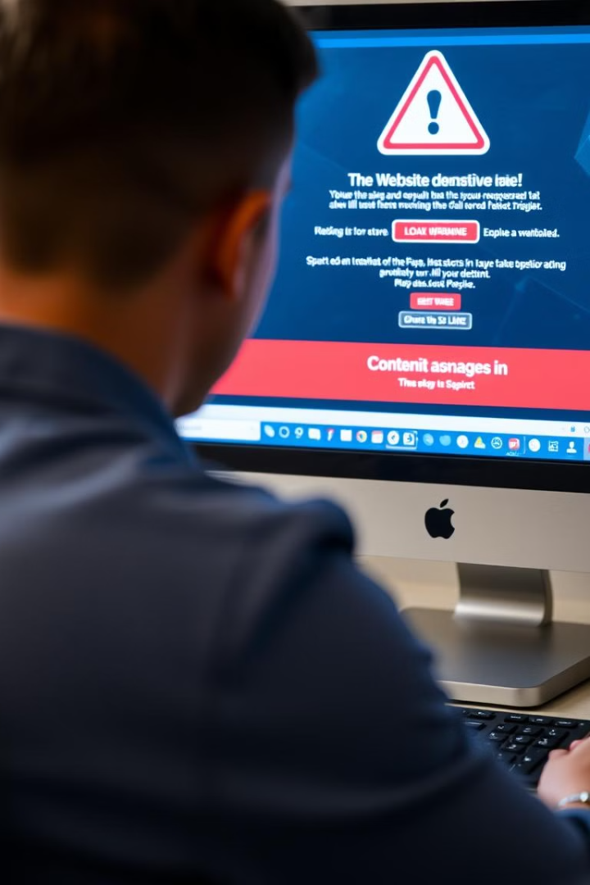




Spotting Phishing Websites
Check the URL: Look for "https" and a padlock icon in the address bar. No lock = No security.
Verify Domain Age: Use tools like Whois to check how long the domain has been registered. Newly registered domains are often suspect.
Look for Misspellings: Phishing sites often use slightly altered domain names.
Check for Contact Information: Legitimate websites should have clear contact details. Absence of contact info = Red flag

Slide 6

Social Engineering Tactics
1
Pretexting: Creating a false scenario to trick victims into providing information. Example: An attacker posing as IT support requesting your password.
2
Baiting: Offering something tempting (e.g., free software, gift cards) to lure victims into clicking a malicious link.
3
Quid Pro Quo: Offering a service in exchange for information. Example: An attacker posing as a survey taker offering a reward.
4
Tailgating: Gaining unauthorized access to restricted areas by following someone who has legitimate access.

Slide 7
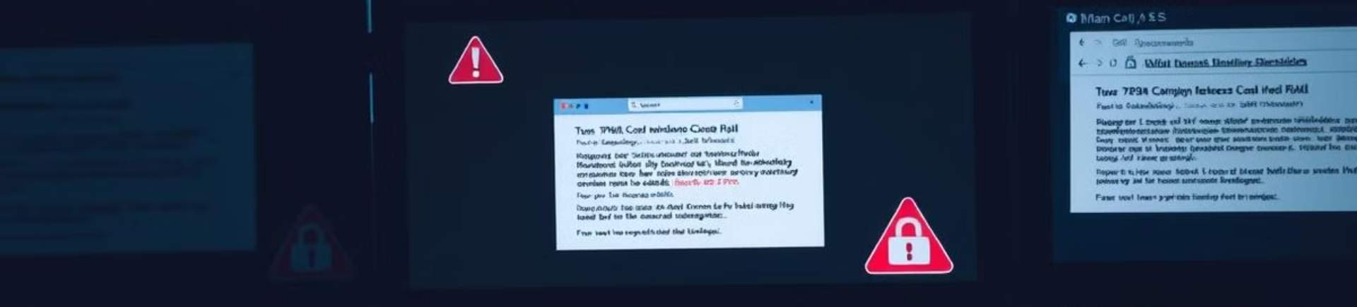




Real-World Phishing Examples
Fake Invoice Scam: An email appearing to be from a supplier with a link to a malicious invoice. Cost businesses $19.1 million in 2023 (Source: IC3).
COVID-19 Phishing: Scammers impersonating health organizations to steal personal information.
Password Reset Scam: An email claiming your password needs to be reset with a link to a fake login page.
IRS Impersonation: Claiming unpaid taxes and threatening legal action to get immediate payment. This scam has cost victims over \$65 million (Source: Treasury Inspector General for Tax Administration)

Slide 8
How to Avoid Phishing Attacks
Think Before You Click: Always verify the sender's identity and the legitimacy of the request.
Use Strong, Unique Passwords: Avoid reusing passwords across multiple accounts. 81% of data breaches leverage weak or stolen passwords (Source: Verizon DBIR).
Enable Multi-Factor Authentication (MFA): Adds an extra layer of security to your accounts.
Keep Software Updated: Regularly update your operating system, browser, and antivirus software.
Report Suspicious Emails: Alert your IT department or security team immediately.
Use a Password Manager: Securely store and generate strong passwords.
Regular Security Audits: Encourage regular security audits of personal and company systems.

Slide 9





What to Do If You Suspect a Phishing Attack
Report
Don't Click
Notify your IT department or security team immediately.
Avoid clicking links or opening attachments in suspicious emails.
2
1
Change Passwords
If you suspect your credentials have been compromised, change your passwords immediately.
3
Malware Scan
5
Monitor Accounts
Use your antivirus software to scan your system for malware.
4
Check your bank statements and credit reports for any unauthorized activity.

Slide 10



Stay Vigilant: The Human Firewall
Verify
1
Sender, Request
Question
2
Urgency, Links, Details
Report
3
Suspicious Activity

Slide 11

Thank You
We appreciate your time and participation in this phishing awareness training.

